Slide 1

BitBlender: Scalable Bloom Filter Acceleration on FPGAs with Dynamic Scheduling
Kenneth (Kenny) Liu, Alec Lu, Zhenman Fang School of Engineering Science Simon Fraser University
Website: sfu.ca/~ksl24
Email: ksl24@sfu.ca

Slide 2
Overview of
Bloom Filters

Slide 3
What is a Bloom Filter?
A Bloom filter represents a probabilistic set.
A Bloom filter is similar to a hash table.
Pro: More space efficient.
Con: Allows false-positives (i.e. saying an element is in the set, but it is not)

Slide 4
What is a Bloom Filter?
A Bloom filter is composed of:
H different hash functions
An array of bits, of length L – the “Bit-vector”
A Bloom filter supports the following operations:
Inserting elements to the set
Querying if an element is in the set

Slide 5
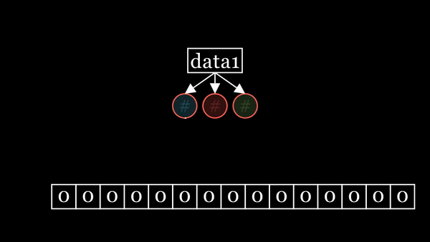
Inserting into a Bloom Filter
Inserting into a Bloom filter:
Initially the bit-vector is all 0’s.
For each inserted element, hash the data to get bit-vector indices
Set all BV[i] to 1.
In this example, we have H=3 hash functions and L=15 bits in the bit-vector.
We are inserting I=2 elements.

Slide 6
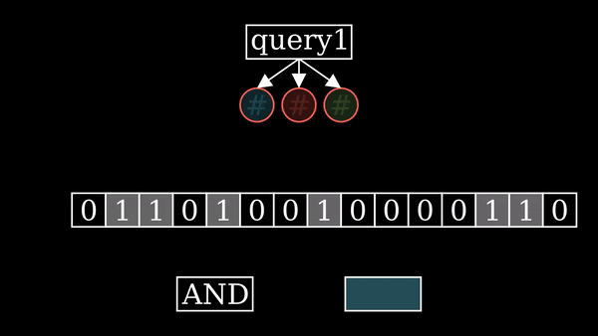
Querying a Bloom Filter
Querying a Bloom filter:
Hash the query to get bit-vector indices
Read all BV[i], and send to an AND operator.
If the result is 0, the query must not have been added to the set.
If the result is 1, the query may have been added to the set.

Slide 7



What are Bloom Filters Used For?
Databases
Bioinformatics
Security
Networking
https://zeenea.com/wp-content/uploads/ 2023/01/databases-zeenea-980x551.jpg
https://www.mayo.edu/research/core-resources/bioinformatics-core/overview
https://www.forbes.com/councils/forbestechcouncil/2024/01/24/cybersecurity-in-2024-challenges-and-innovations-in-a-volatile-era/
Notes:
Here are some use cases of Bloom filters. The common thread between these is that the Bloom filter is space-efficient, and fits in smaller and faster memory. So we first ask “is this input POTENTIALLY useful?” and then if we think that it probably is useful, then we can query the full, slower dataset.
IMAGE LINKS:
https://zeenea.com/wp-content/uploads/2023/01/databases-zeenea-980x551.jpg
https://www.google.com/url?sa=i&url=https%3A%2F%2Fwww.mayo.edu%2Fresearch%2Fcore-resources%2Fbioinformatics-core%2Foverview&psig=AOvVaw3Tm_mxrLG4sNOTwRnK0aY3&ust=1723764386233000&source=images&cd=vfe&opi=89978449&ved=0CBEQjRxqFwoTCMCipfHQ9YcDFQAAAAAdAAAAABAE
https://www.google.com/url?sa=i&url=https%3A%2F%2Fwww.forbes.com%2Fsites%2Fforbestechcouncil%2F2024%2F01%2F24%2Fcybersecurity-in-2024-challenges-and-innovations-in-a-volatile-era%2F&psig=AOvVaw3NTqmaTUGp3NksjDP7j9Og&ust=1724173007255000&source=images&cd=vfe&opi=89978449&ved=0CBQQjRxqFwoTCOjm1o7DgYgDFQAAAAAdAAAAABAE

Slide 8
How do I Design a Bloom Filter?
Algorithmically, there are three parameters that can be changed in a Bloom filter.
H: The number of hash functions.
L: The length of the bit-vector.
I: The desired number of elements to insert.
In this figure, we have H=3 hash functions and L=15 bits in the bit-vector.
We are inserting I=2 elements.

Slide 9
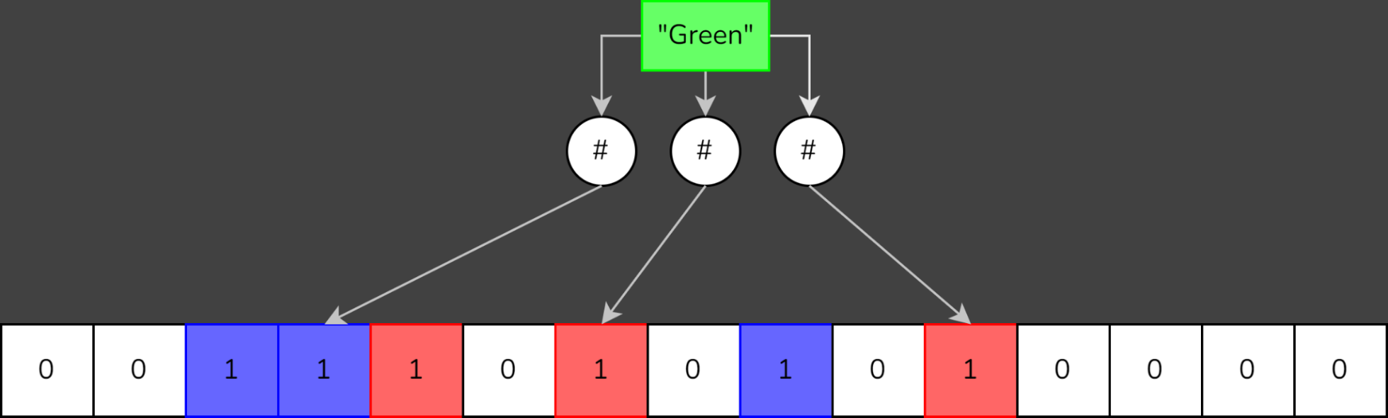
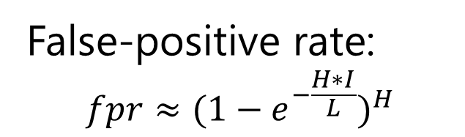
How do I Design a Bloom Filter?
There is a possibility of false positives. That is, a query may return 1, even though the queried element was not added to the set.
Increasing L (bit-vector length) decreases false-positive rate.
Increasing I (number of insertions) increases false-positive rate.
Changing H (# hash functions) affects it non-monotonically.
False-positive rate:
$$fpr≈{(1−e^{−\frac{H∗I}{L}})}^{H}$$
Notes:
SPEND LITTLE TIME ON THIS SLIDE. Simply say “

Slide 10
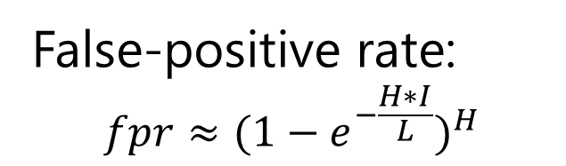
How do I Design a Bloom Filter?
There is a possibility of false positives.
Increasing L (bit-vector length) decreases false-positive rate.
Good Bloom filters need large bit-vectors.
False-positive rate:
$$fpr≈{(1−e^{−\frac{H∗I}{L}})}^{H}$$
Notes:
SPEND LITTLE TIME ON THIS SLIDE.
Script: “As we mentioned, there’s a possibility of false positives. The formula for false-positive rate is shown at the bottom of the slide, but the key takeaway here is that increasing the size of the bit-vector decreases false-positive rate; in other words, good bloom filters need large bit-vectors.”

Slide 11
Presentation Overview
Introduction to the Bloom Filter Data Structure
Accelerating Bloom Filters on FPGA
The BitBlender Architecture Template
Leveraging Dynamic Scheduling
Deadlock Prevention
BitBlender Scalability & Automated Design Exploration
Experimental Results
Conclusion
Notes:
SCRIPT: “Here’s a brief overview of the remainder of this talk. We’ve already introduced Bloom Filters.”
“Next, we’ll talk about accelerating Bloom Filters on FPGA, and we’ll build up to the BitBlender architecture template. Along the way, we’ll talk about how we leverage dynamic scheduling, and how we implement deadlock prevention.”
“Then we’ll discuss the scalability of BitBlender, and our automated design exploration.”
“Finally, we’ll show our experimental results, and finish with a conclusion.”

Slide 12
BitBlender: An HLS Bloom Filter Accelerator on FPGA

Slide 13
Why FPGAs for Bloom Filter Acceleration?
Modern datacenter FPGAs have large on-chip SRAM memories
Bloom filters are meant to be space-efficient, so they will can fit on SRAM.
The computations in a Bloom filter are hashes, and AND operations.
These have many bit-level operations, which FPGAs excel at.

Slide 14
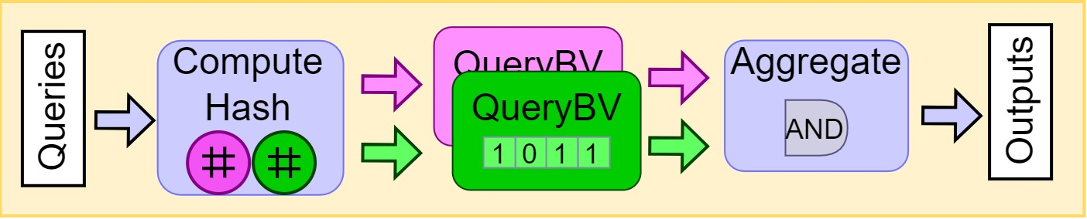
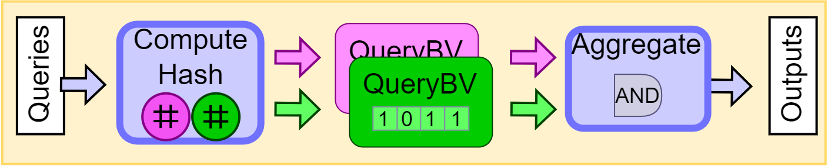
Baseline Bloom Filter Accelerator
ComputeHash reads queries from off-chip memory and computes the H hash functions (Here, H=2).
QueryBV will read from each hash function. Each hash function addresses its own section of the bit-vector, in fast on-chip memories.
On-chip memories have 2 ports → need two ComputeHash/Aggregates
Aggregate ANDs the H bits together, to get an output.
Notes:
Make sure to mention that QueryBV stores the bit-vector in FAST, ON-CHIP SRAM MEMORY.

Slide 15
Baseline Bloom Filter Accelerator
Fully pipelined, streaming design can perform two queries per cycle
Because BRAM/URAM have two ports.
This is a good starting point introduced by Harwayne-Gidansky et al. We call this our “baseline design".

Slide 16
Further Parallelization Opportunities
Can we do better than 2 queries per cycle?
i.e. can we have more than one input stream? S input streams?
Simple solution: Duplicate the baseline design S times
With large bit-vectors, we run out of on-chip memory.
BitBlender: Duplicate only the computation modules S times, but share the bit-vector among the S input streams

Slide 17
Simple Parallelization
Simple solution: Duplicate the entire design S times
Here is the resource usage of our baseline streaming design, supporting I=9M insertions at 0.1% false positive rate:
Too much BRAM/URAM usage. Cannot be duplicated.
Example Design Resource Usage | LUTs | FFs | BRAMs | URAMs | DSPs
 | 10.1% | 6.2% | 56.1% | 40.0% | 1.4%

Slide 18
BitBlender - Challenges
BitBlender: Duplicate only the computation modules S times, but share the bit-vector among the S input streams
Challenges:
Q: How do we share the bit-vector?

Slide 19
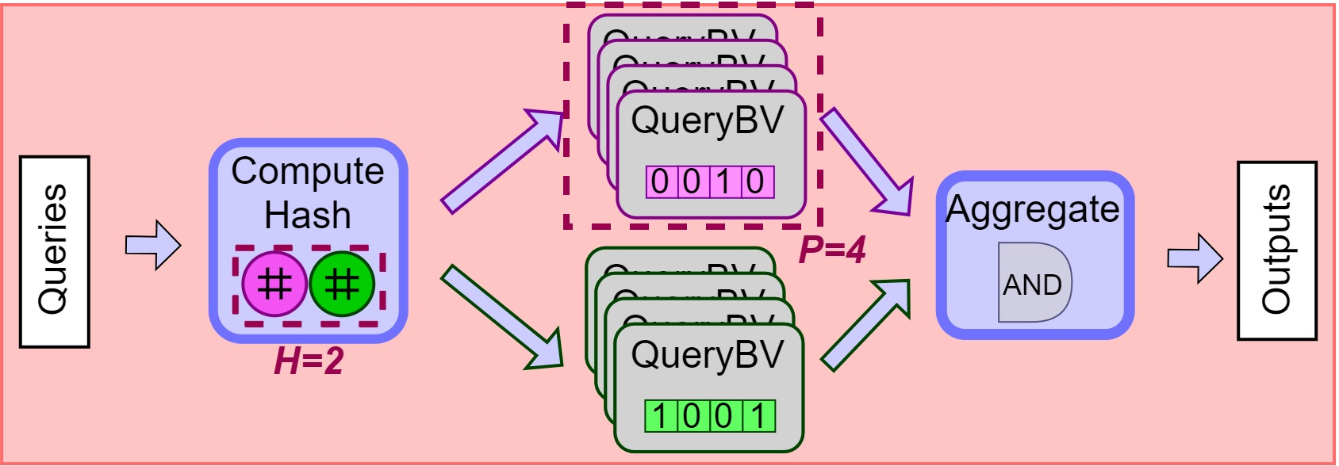
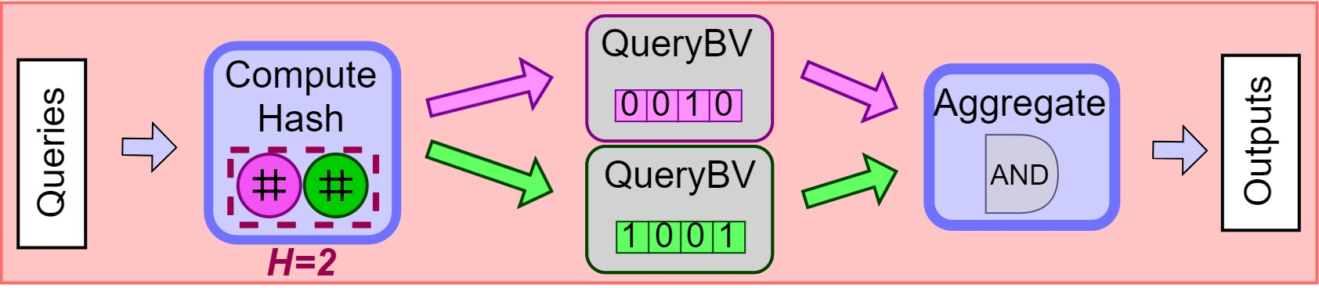
Building BitBlender – Partitioning the Bit-Vector
How do we share the bit-vector?
Share memories among queries, by array-partitioning.
Each bit-vector section will be further partitioned to allow parallel access.

Slide 20
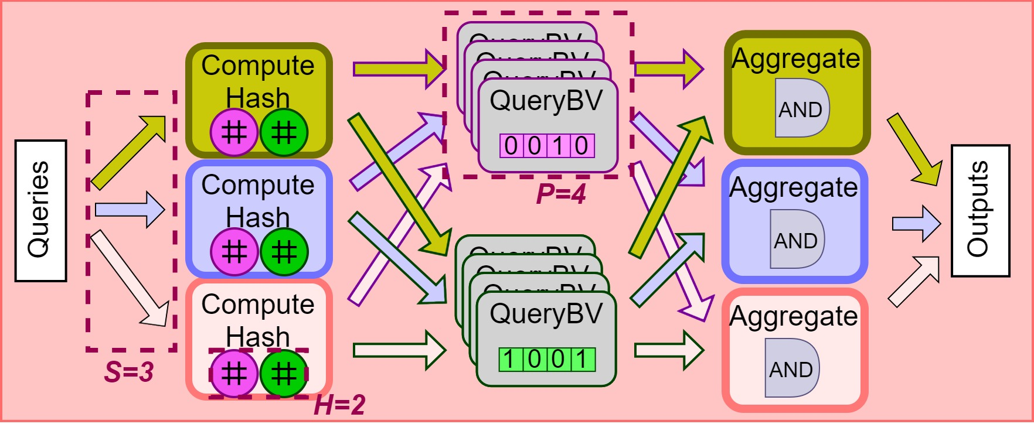
Building BitBlender – Partitioning the Bit-Vector
Ok, now let’s add more query streams…
We need one copy of compute/aggregate, for each new stream.

Slide 21
Building BitBlender – Partitioning the Bit-Vector
Issue: The static scheduler detects access conflicts.
Initiation Interval = II = S

Slide 22
Building BitBlender – Access Conflicts
What are these access conflicts?
The data in each packet decides which partition it goes to.
If we get unlucky, data from different streams will access the same partition.
S₀
S₁
#
#
No conflict
Conflict
0
1
1
0
0
0
1
0
0
1
0
0
1
0
0
1
P₀
P₁
P₀
P₁
Notes:
Here we see an example with 2 streams: red and a blue stream.
They both send data to a purple hash function, and a green hash function.
For the purple hash function’s bit-vector section, the blue stream and the red stream collide in the same partition. This is an access conflict.
For the green hash function’s bit-vector section, the blue stream and the red stream access separate partitions. This is NOT an access conflict.

Slide 23
BitBlender - Challenges
BitBlender: Duplicate only the computation modules S times, but share the bit-vector among the S input streams
Challenges:
Q: How to share the bit-vector? A: Introduce partitions, P
Q: How do we manage access conflicts?

Slide 24
Building BitBlender – Access Conflicts
It’s impossible to guarantee that access conflicts will not occur.
Because each packet’s target partition is input-dependent.
We will dynamically schedule conflicting accesses in sequential, and non-conflicting accesses in parallel.
S₀
S₁
#
#
No conflict
Conflict
0
1
1
0
0
0
1
0
0
1
0
0
1
0
0
1
P₀
P₁
P₀
P₁
Notes:
Here we see an example with 2 streams: red and a blue stream.
They both send data to a purple hash function, and a green hash function.
For the purple hash function’s bit-vector section, the blue stream and the red stream collide in the same partition. This is an access conflict.
For the green hash function’s bit-vector section, the blue stream and the red stream access separate partitions. This is NOT an access conflict.

Slide 25
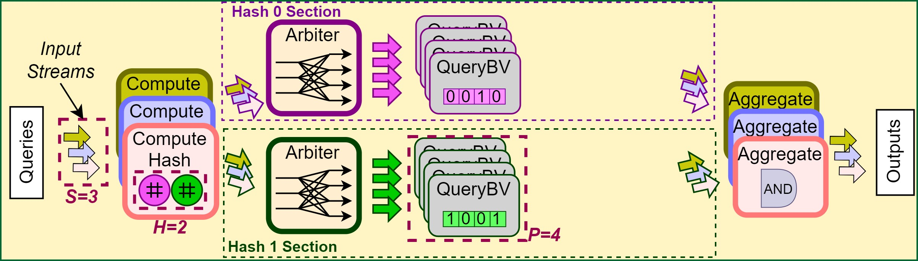
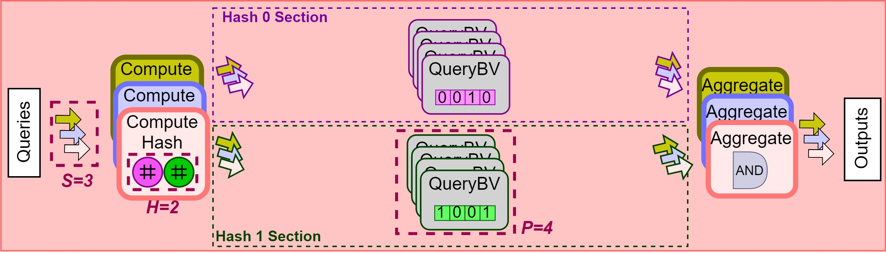
Building BitBlender – Arbiter
To facilitate access-conflict-management, we add a new module:
Stream-to-Partition Arbiter

Slide 26
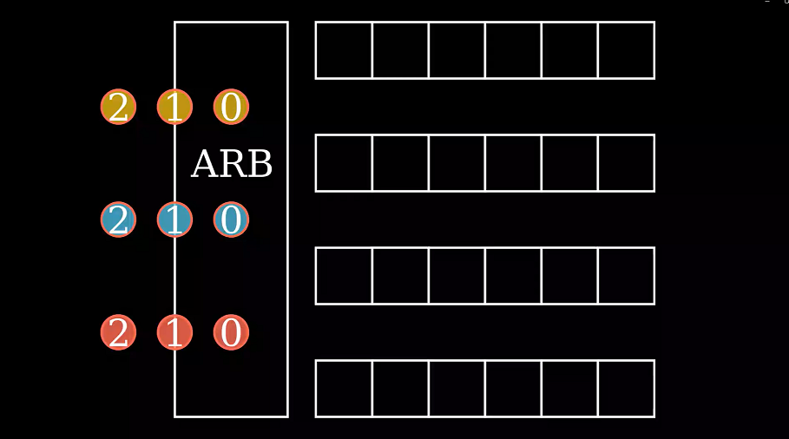
Building BitBlender – Arbiter
Stream-to-Partition Arbiter has S input fifos, and P output fifos.
For each partition, it will serialize incoming requests. This removes access conflicts.
Notes:
In the figure we have 3 input FIFOs and 4 output FIFOs.
We read inputs from a gold stream, blue stream, and red stream

Slide 27

Building BitBlender – Arbiter Execution Example
The Arbiter dynamically schedules accesses, for high throughput.
Notes:
The video showcases the fact that the Arbiter serializes the packets if there is an access conflict, but allows parallel access if there is no access conflict

Slide 28
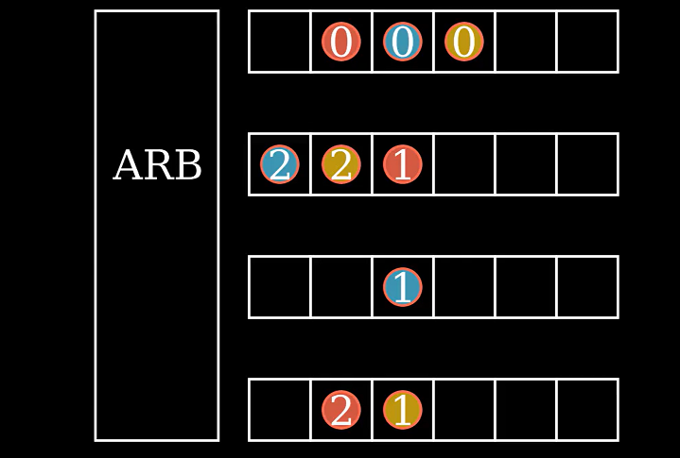
Building BitBlender – The Problem with Arbiter
Issue: Packets are now mixed around, in partitions, rather than streams.
But we still need to aggregate each stream’s data – need data organized by stream.
We also need data to be ordered properly.
Notes:
When these packets get to Aggregate, they need to grouped by color. Because the gold aggregate should only read data from the gold input stream.
But as-is, the data is mixed around.

Slide 29
BitBlender - Challenges
BitBlender: Duplicate only the computation modules S times, but share the bit-vector among the S input streams
Challenges:
Q: How to share the bit-vector? A: Introduce partitions, P
Q: How to manage access conflicts? A: Introduce Arbiter, to dynamically control access.
Q: How can Aggregate work properly after introducing the Arbiter?

Slide 30
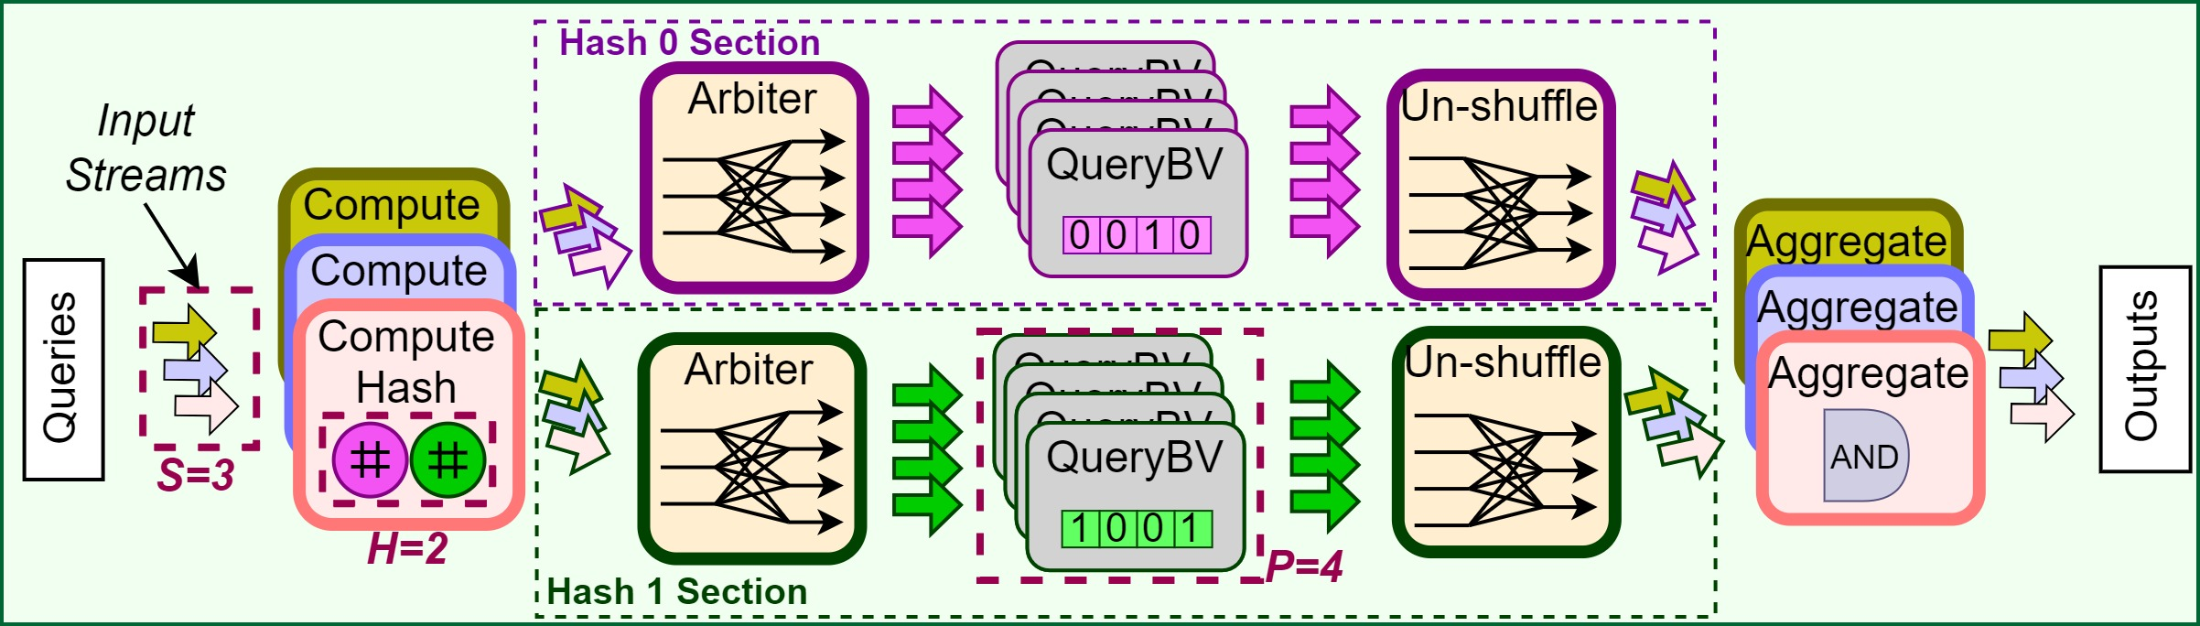
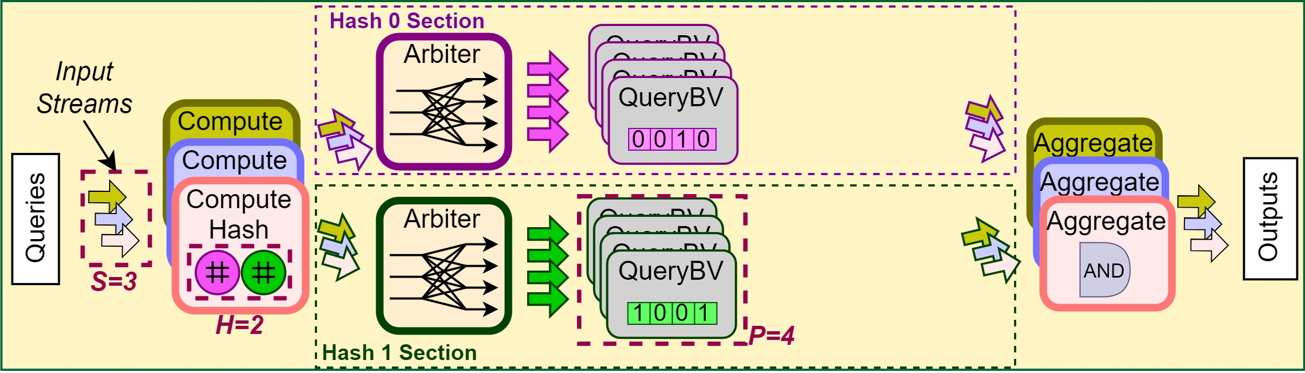
Building BitBlender – UnShuffle
Solution: Partition-to-Stream UnShuffle module.

Slide 31
Building BitBlender – UnShuffle
The P-to-S Unshuffle has P input FIFOs, and S output FIFOs
Unshuffle serves 2 purposes:
Unmix packets, from partitions into streams (i.e. separate out the packet colors)
Reorder packets, in terms of input-ordering.
Notes:
The Unshuffle module is a bit like the opposite of the arbiter: it has P input FIFOs, and S output FIFOs.
It has two purposes: first, it un-mixes the packets in terms of COLOR. Second, it re-orders the packets in terms of INPUT ORDERING.
Recall, the packets in this figure were read in the order “0, 1, 2”. And the order of the output needs to match the input ordering.

Slide 32
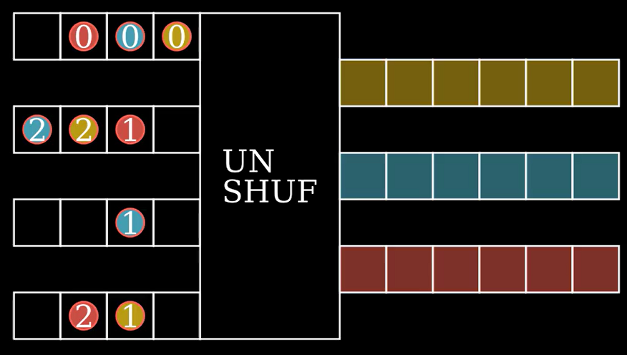
Building BitBlender – UnShuffle Execution Example
Unshuffle serves 2 purposes:
Unmix packets, from partitions into streams (i.e. separate out the packet colors)
Reorder packets, in terms of input-ordering.

Slide 33
BitBlender – Aggregate Behaviour
Aggregate requires H inputs to all be available to compute 1 output.
Re-convergent module
Issue: This design can deadlock.
Notes:
SCRIPT: “In the interest of time, we have to skip over these slides… but the key takeaway is that we have the possibility of a deadlock, due to the re-convergent behaviour of the Aggregate module, because it needs to combine data from the different hash functions.”

Slide 34
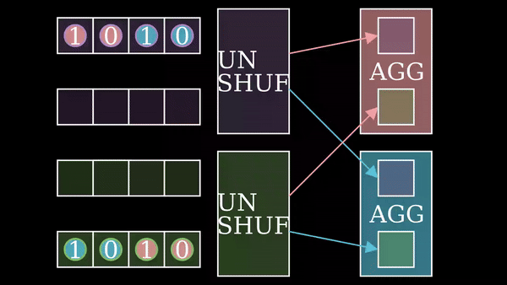
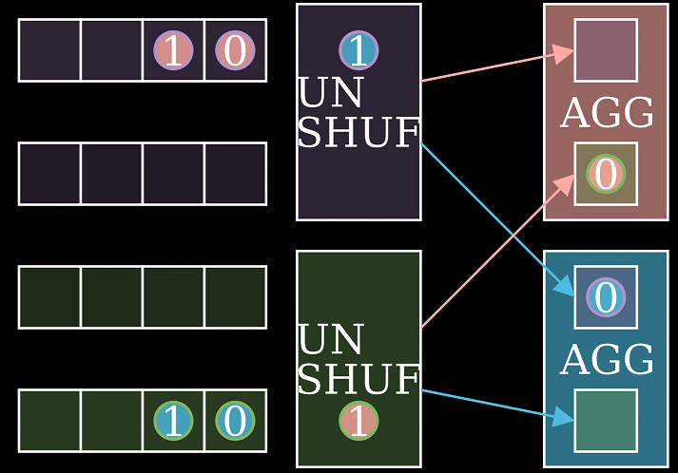
BitBlender - Deadlock Example
Circular dependency:
Blue Agg waits until it gets Green section’s in0.
in0 is behind in1. Green Unshuf waits until Red Agg can accept its in1.
Red Agg waits until it gets Purple section’s in0.
in0 is behind in1. Purple Unshuf waits until Blue Agg can accept its in1.

Slide 35
BitBlender - Challenges
BitBlender: Duplicate only the computation modules S times, but share the bit-vector among the S input streams
Challenges:
Q: How to share the bit-vector? A: Introduce partitions, P
Q: How to manage access conflicts? A: Introduce Arbiter, to dynamically control access.
Q: How can Aggregate work properly after introducing the Arbiter? A: Introduce UnShuffle, to reorder data packets
Q: How do we implement deadlock prevention?

Slide 36
BitBlender Deadlock Prevention
The problem is out-of-order packets, between different streams in different hash sections.
Notes:
SCRIPT: “The underlying problem is that we have out-of-order packets, between different streams in different hash functions.”

Slide 37
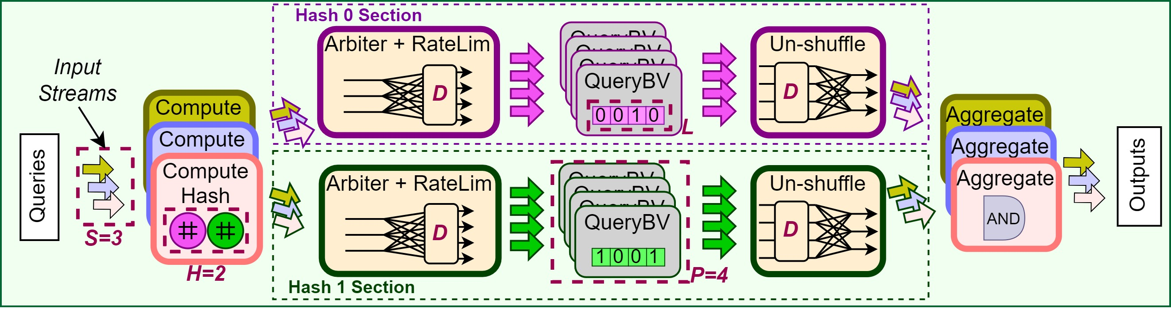
BitBlender – Rate-limiting and Buffering
Solution: Add Rate-limiting logic to the Arbiter, and Buffering to the UnShuffle unit:
Arbiter keeps track of the slowest stream – the stream with the least data sent
Other streams can only send D more packets than the slowest stream at any time.
Notes:
SCRIPT: “So to solve this, we add rate-limiting logic to the Arbiter, and buffering to the Unshuffle unit.” “The rate-limiting logic puts a guarantee on how out-of-order our data can get, represented by ‘D’.”
“And the buffer guarantees that, if our data is out-of-order by this amount ‘D’, we can recover from it.”

Slide 38
BitBlender - Challenges
BitBlender: Duplicate only the computation modules S times, but share the bit-vector among the S input streams
Challenges:
Q: How to share the bit-vector? A: Introduce partitions, P
Q: How to manage access conflicts? A: Introduce Arbiter, to dynamically control access.
Q: How can Aggregate work properly after introducing the Arbiter? A: Introduce UnShuffle, to reorder data packets
Q: How do we implement deadlock prevention? A: Rate-limiting in the Arbiter, and buffering in UnShuffle.

Slide 39
BitBlender Configurability and Automated Design Exploration

Slide 40
Finalized Bitblender Accelerator Template
We have finally described the BitBlender accelerator template.
5 parameters: H, P, S, D, L

Slide 41
Automated Design Exploration
To support high configurability:
HLS Code Generator
Automated Design Explorer

Slide 42
Automated Design Exploration
User specifies target FPGA and Bloom filter algorithmic parameters
Automatically predict & generate the optimal BitBlender design
USER INPUT:
LEGEND
FPGA Platform Info Resource Capacity
Algo. Parameters I, fp, (optional: L)
Our Tools
Existing Tools
BitBlender Configuration Calculator
Proposed BitBlender H,P,S,D,L
Remove failed config & try again
Build Success?
N
Y
BitBlender Template
Pick Best
Performance Estimator
Vitis
Optimized BitBlender Design
BitBlender TAPA-HLS Code
Code Generator
TAPA [TRETS’24]
TOOL OUTPUT

Slide 43
Experimental Results

Slide 44
Experimental Results
These results were run on FPGA, using randomized queries.
AMD/Xilinx Alveo U280
Vitis and Vivado v2021.2

Slide 45
Experimental Results
BitBlender vs Baseline Design vs optimized 24-thread CPU
CPU has 192 GB RAM, 16.5MB L3 Cache.
Notes:
SCRIPT: “Here we compare BitBlender against the baseline design, and against an optimized 24-thread CPU implementation.”
“The CPU in question has 192GB of RAM, and 16.5MB L3 cache.”
“On the y-axis, we show the throughput in million-queries-per-second, and on the x-axis, we show the Bloom filter configuration – the number of insertions, and the expected false-positive rate.”
(next slide)

Slide 46
Experimental Results
Average 9.1x speedup over CPU, up to 10.4x
Average 3.6x speedup over duplicated baseline design, up to 4.9x

Slide 47
Experimental Results
BitBlender Configuration: H=9, S=1-6, P=8, D=16, L=144M.
Almost linear throughput increase – dynamic dataflow stalls are very rare.
Notes:
SCRIPT: “In these slides, we’re doing an ablation study on the BitBlender configurations. Here, we’re sweeping through different numbers of streams.”

Slide 48
Experimental Results
BitBlender Configuration: H=9, S=6, P=2-8, D=16, L=144M.
Highlights dynamic stalling: with P<S, we’re bottlenecked by P.
Max-flow, min-cut. Expected throughput scales with Min(S,P)
Notes:
SCRIPT: “Here, we show throughput against number of partitions.”
Show the S=2 and S=4 in the previous slide, and show how the P=2 and P=4 throughput are very similar.
SCRIPT: “This is not a coincidence; the expected throughput scales with the minimum between S and P.”

Slide 49
Experimental Results
BitBlender Configuration: H=3-9, S=6, P=8, D=16, L=144M.
H only affects throughput by affecting achievable frequency.
Notes:
SCRIPT: “Here we’re sweeping through the number of hash functions. We plot it alongside the frequency; as shown, the achieved frequencies decrease to about 150 as the number of hash functions increases to H=9.” “And the throughput is tightly linked to the frequency – showing that the number of hash functions has little effect on the dynamic stall right.”

Slide 50
Experimental Results
BitBlender Configuration: H=9, S=6, P=8, D=2-16, L=144M.
Lower D → Harsher Ratelimiting → dynamic stalls increases significantly.
Notes:
SCRIPT: “Here we see a parameter that does have significant effect on dynamic dataflow rate: the arbiter ratelimiting distance.”
“When the ratelimiting distance is low, we have a very high dynamic stall rate.”
“However, when ratelimiting distance is 16, our throughput is very good – in fact, it almost meets our manually-calculated peak throughput, which is the throughput we would achieve if we had ZERO dataflow stalls.”
“So when D=16, our design is very efficient, and introduces almost no stalls.”

Slide 51
Conclusion

Slide 52
Conclusion
We have presented BitBlender: a scalable Bloom filter accelerator on FPGA, enabled by dynamic scheduling.
We achieve up to 10.4x speedup over a highly-optimized 24-thread CPU implementation
We achieve up to 4.9x speedup over the naively-duplicated FPGA design

Slide 53





Acknowledgements
Notes:
Finally, I would like to thank all our sponsors. I will now be happy to take questions

Slide 54
Thank you!
Questions?

Slide 55
Appendix A – Prior Work Comparison
BitBlender is, to the best of our knowledge, the first Bloom filter accelerator to share the bit-vector between query-streams.
Work | #Hash Functions | Throughput (MQuery/s) | Frequency | L | I @ fpr = 0.1%
BitBlender (Ours) | 8 | 1,890 | 158 | 128M | 9.2M
 | 9 | 1,763 | 146 | 144M | 10.3M
 | 12 | 1,515 | 150 | 96M | 6.9M
Sateesan et al 2022 | 12 | 925 | 462 | 0.25M | 1.1k
BunchBloomer (Kang et al) 2022 | 8 | 47 | 250 | 512M | 36.8M

Slide 56
Appendix A – Prior Work Comparison
Sateesan et al implemented a super-high-frequency hashing function. With larger memories they may face critical paths in the bitvector lookup, versus the hash function.
BunchBloomer implemented the bit-vector on off-chip DRAM, and focus on bunching the bit-vector accesses together to leverage memory-bursting for high throughput.
Work | #Hash Functions | Throughput (MQuery/s) | Frequency | L | I @ fpr = 0.1%
BitBlender (Ours) | 8 | 1,890 | 158 | 128M | 9.2M
 | 9 | 1,763 | 146 | 144M | 10.3M
 | 12 | 1,515 | 150 | 96M | 6.9M
Sateesan et al | 12 | 925 | 462 | 0.25M | 1.1k
BunchBloomer | 8 | 47 | 250 | 512M | 36.8M

